Slide 1
Breast Cancer Classification
that help select which treatment approach is anticipated to have the best chance for a good outcome, with increased efficacy and low toxicity

Slide 2
Breast Cancer: The Concern
39,800 breast cancer related deaths were appropriated in 2003.
In the United States, of the 40,600 deaths from breast cancer in 2001, 400 were men.
It is the leading cause of cancer deaths among women ages 40—59
It is the second leading cause of death for women in the US.
According to the World Health Organization, starting from 2010, cancer will become the leading cause of death worldwide.
One in every 3 cancer is a breast cancer.

Slide 3
Introduction
Breast cancer classification divides breast cancer into malignant and benign.
Classification Aspects like:
histolopathological type
grade of the tumour
stage of the tumour
expression of proteins and genes

Slide 4
Objective
Appropriate Selection of Treatment Method
Early Diagnosis and Treatment
Research in this area is booming especially owing to:
High incidence of Breast Cancer
High recurrence of Records

Slide 5
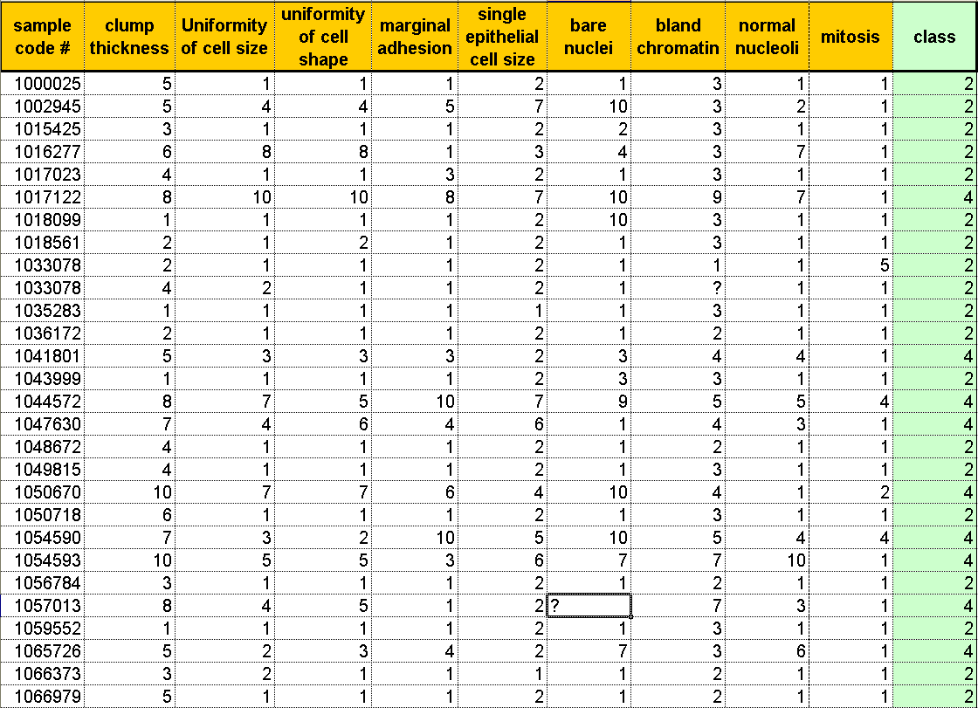
Breast Cancer Dataset
Wisconsin Breast Cancer Database (1991)
University of Wisconsin Hospitals,
Dr. William H. Wolberg
# of Instances: 699
# of Attributes: 10 plus Class attribute
Class distribution:
Benign (2): 458 (65.5%)
Malignant (4): 241 (34.5%)

Slide 7
Data Mining Methods
Two popular data mining algorithms (artiﬁcial neural networks and decision trees) along with a most commonly used statistical method (logistic regression) to develop the prediction models using a large dataset (more than 200,000 cases).
We also used 10-fold cross-validation methods to measure the unbiased estimate of the three prediction models for performance comparison purposes.

Slide 8
Chosen Predictor
The results indicated that the decision tree (C5) is the best predictor with 93.6% accuracy on the holdout sample (this prediction accuracy is better than any reported in the literature).
Artiﬁcial neural networks came out to be the second with 91.2% accuracy.
Logistic regression models came out to be the worst of the three with 89.2% accuracy.

